Slide 1
Power Management with DVFS
Instructor: Zonghua Gu
Notes:
1. Sources of Power Dissipation
2. Reducing Power Consumption
3. System Level Power Optimization
4. Dynamic Power Management
5. Mapping and Scheduling for Low Energy
6. Real-Time Scheduling with Dynamic Voltage Scaling

Slide 2
The Case for Power Awareness

Slide 3
Where does the Power Go?
We focus on CPU power
Peripherals
Processing
Disk
Display
Programmable
μPs & DSPs
(apps, protocols etc.)
ASICs
Memory
Power Supply
DC-DC
Converter
Communication
Radio
Modem
RF
Transceiver
Battery

Slide 4
Leakage vs. Dynamic
Leakage power (static power) is consumed even if the circuit is idle (standby mode). The only way to avoid it is to turn off the CPU.
The only way to reduce leakage power is to turn off the power supply
Dynamic power is still the main source of power consumption.
In the past, Leakage power was considered negligible compared to dynamic power.
Today, Leakage power is approaching or exceeding size of dynamic power.

Slide 5
Dynamic Power/Energy
Power consumption：P=ɑ*C*V²*f
ɑ: switching factor
C: effective capacitance
V: operating voltage
f: operating frequency
Energy consumption for task with execution time t_{exe}:
E=P*t_{exe}=ɑ*C*V²*f*t_{exe}=ɑ*C*V²*N_{cycles}
N_{cycles}: total execution cycles. (it is obvious that t_{exe}=N_{cycles}/f)
Assuming f ∝ V (approximation):
P ∝ V³ ∝ f³; E ∝ V² ∝ f²
Notes:
N_{CY}=number of CPU cycles to finish running the task
Sometimes we are concerned about power consumption:
- heath dissipation, cooling:
- physical deterioration due to temperature.
• Sometimes we want to reduce total energy consumption:
- battery life.

Slide 6
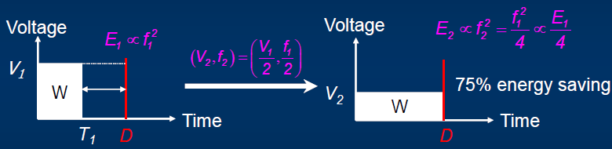
Reducing Power Consumption
Given power consumption P=ɑ*C*V²*f, we can reduce P by:
At device level:
reduce capacitance C
At system level:
Reduce CPU voltage V
Reduce CPU frequency f
Notes:
Reduce number of cycles N_{CY}=f*t

Slide 7
Power vs. Energy
Which is more important?
Sometimes we care about power consumption:
heat dissipation, cooling
physical deterioration due to temperature.
Sometimes we care about total energy consumption:
battery life for portable devices
power bills (money) for large servers

Slide 8
Dynamic Voltage and Frequency Scaling (DVFS)
A device can be run at different speeds at several different (supply voltage, CPU frequency) pairs
Supply voltage can be chosen by the OS through execution of particular instructions. CPU frequency is automatically adjusted to fit the current supply voltage.
Execution of jobs can be slowed down to save power as long as all jobs are completed by their deadline.

Slide 9
Scheduling w/ DVFS
Reducing supply voltage increases execution time!
The scheduling problem:
Which task to execute at a certain moment on a certain processor, and at which voltage level, so that time constraints are fulfilled and energy consumption is minimized?
Notes:
The scheduling problem:
Which task to execute at a certain moment on a certain processor so that time constraints are fulfilled?

Slide 10
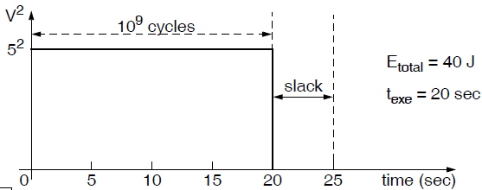
Example
Consider a task τ, and CPU runs at full speed until τ finishes:
Processor nominal (maximum) voltage: 5V.
Total computation: 10⁹ execution cycles; deadline: 25 seconds.
CPU frequency: 50MHz (50 million cycles/sec) at nominal voltage; Energy per cycle: 40 nJ/cycle at nominal voltage.
Execution time t_{exe}= 10⁹ (cycles)/50*10⁶ (cycles/sec)=20 s
Total energy E_{total} = 10⁹ (cycles) * 40 (nJ/cycle)=40 J

Slide 11
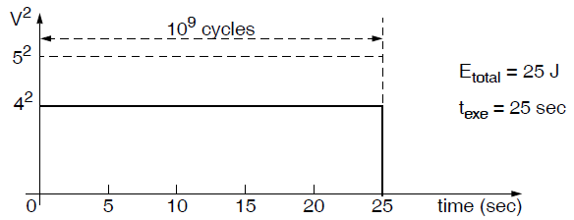
Reduced Voltage & Frequency
Reduce voltage at time 0 to V = 4V
CPU frequency: 50*(4/5) = 40MHz；Energy per cycle: 40*(4/5)² = 25nJ/cycle.
Execution time t_{exe}= 10⁹(cycles)/40*10⁶ (cycles/sec)=25 s
Total energy E_{total}= 10⁹ (cycles) * 25 (nJ/cycle) = 25 J
Notes:
Reduce voltage at time 0 to V = 2.5V
CPU frequency: 50*(2.5/5) = 25MHz；Energy per cycle: 40*(2.5/5)² = 10nJ/cycle.
Execution time t_{exe}=750*10⁶(cycles)/50*10⁶ (cycles/sec) + 250*10⁶(cycles)/25*10⁶ (cycles/sec) =15+10=25s
Total energy E_{total}=750*10⁶ (cycles) * 40 (nJ/cycle) + 250*10⁶ (cycles) * 10 (nJ/cycle)=32.5 J
Reduce voltage at time 0: V_{DD} = 4V
Energy per cycle : 40*(4/5)² = 25nJ/cycle.
CPU frequency: 50*(4/5) = 40MHz

Slide 12
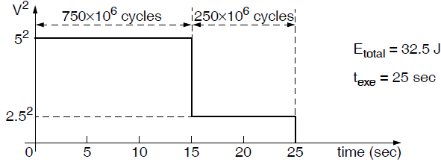
Reduced Voltage & Frequency
Reduce voltage at time 15 to V = 2.5V
CPU frequency: 50*(2.5/5) = 25MHz；Energy per cycle: 40*(2.5/5)² = 10nJ/cycle.
Execution time t_{exe}=750*10⁶(cycles)/50*10⁶ (cycles/sec) + 250*10⁶(cycles)/25*10⁶ (cycles/sec) =15+10=25 s
Total energy E_{total}=750*10⁶ (cycles) * 40 (nJ/cycle) + 250*10⁶ (cycles) * 10 (nJ/cycle)=32.5 J

Slide 13
Basic Principle
If a processor uses a single supply voltage and completes a program at exactly the deadline moment, the energy consumption is minimized.

Slide 14
[Zhang10]
Xiao Zhang et al, An Evaluation of Per-Chip Non-Uniform Frequency Scaling on Multicores, 2010
Similarity grouping:
On a multi-chip system, group applications with similar last level cache (LLC) miss ratios to run on the same multicore processor chip, in order to lower the voltage/frequency of the chip running memory-intensive tasks w/ high LLC miss ratios.
Question from audience
On a multi-chip system, tasks running on different chips may interfere with each other. Even though they do not share CPU, the share the bus, interconnect, memory controller, etc.
Answer: Their Frequency-to-Performance Model did not consider this interference, hence may not be very accurate.

